Slide 1
Task: Devices
PREPARING FOR A TASK SOLUTION
PRESENTED BY LILLA TÓTH

Slide 2

Introduction
L
Workexperiences
  Project manager
  Financial assistant
Hobbys and dreams
  Reading, turtles, series, garden
toth.lilla88@gmail.com

Slide 3
Fourth week tasks
More about classes
Inheritance with classes
Abstract classes
Unit testing by Google test

Slide 4
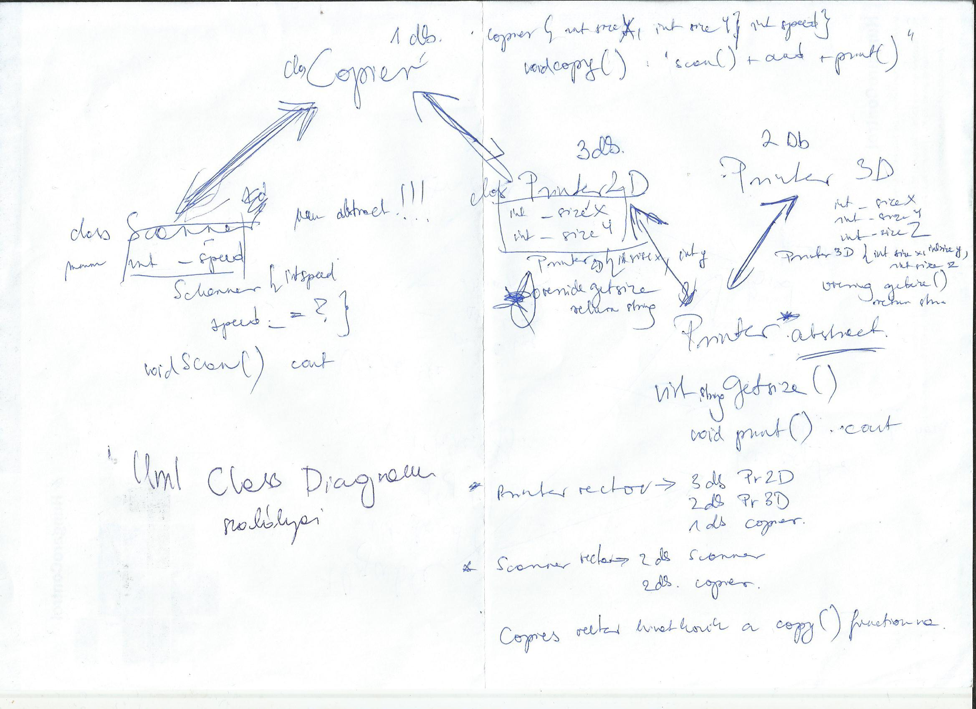
Week 4 – Day 3 The Devices project

Slide 5
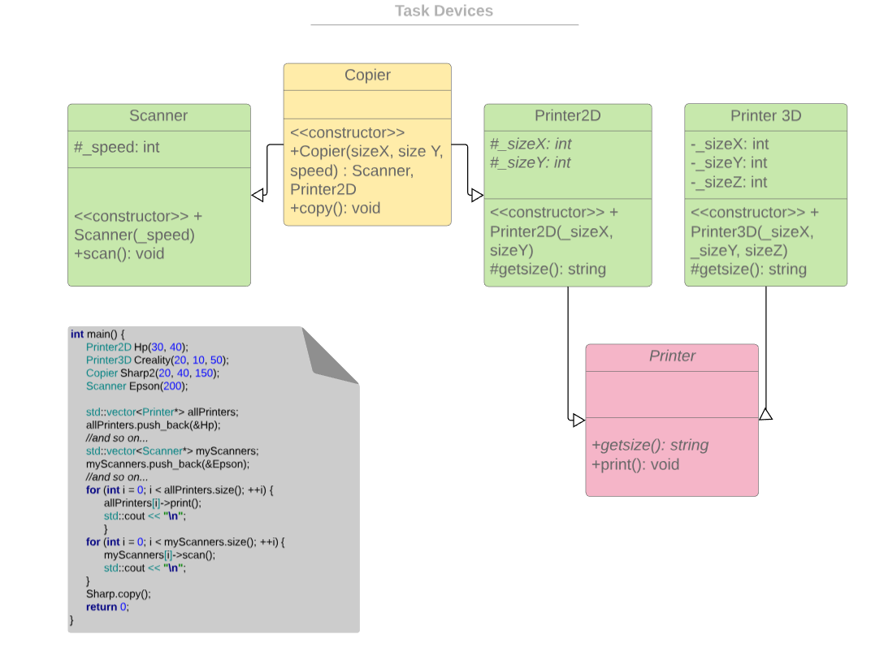
UML Class Diagram

Slide 6
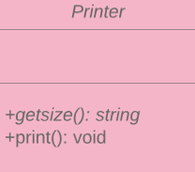
Printer(abstract)
getSize() pure virtual function
print() function that writes "I'm printing something that's getSize() cm."

Slide 7
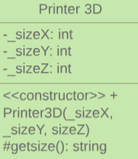
Printer3D
class member:
  _sizeX: int
  _sizeY: int
  _sizeZ: int
constructor that gets 3 integers and assigns sizeZ, sizeY and sizeZ with it.
override getSize() function that returns a string which looks like: "_sizeX + X + _sizeY + X + _sizeZ"

Slide 8
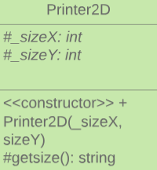
Printer2D
class member:
  _sizeX: int
  _sizeY: int
constructor that gets 2 integers and assigns sizeX and sizeY with it
override getSize() function that returns a string which looks like: "_sizeX + X + _sizeY";

Slide 9
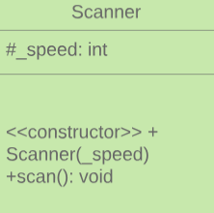
Scanner
class member:
  _speed: int
constructor that gets an integer and assigns speed with it
scan() function which prints: "I'm scanning a document speed() ppm" to the console

Slide 10
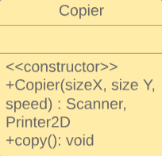
Copier
constructor that gets 3 integers and assigns sizeX, sizeY and speed with it.
copy() function that prints the following to the console: "scan() + and + print()".

Slide 11
If I could turn back time….
THANK YOU FOR WATCHING!
SEE YOU NEXT TIME!

